Slide 1



Super Awesome Team Presents:
Data Analysis on Student Enrolment

Slide 2

Back Story
As a team we decided to take the data from a University of student enrolment and analyze it . We used Machine Learning and tableau to present and evaluate our Data .
The various process involved data cleaning and before deciding what stream of data we were going to use we took an in depth look at the information we were able to pull from the databases .

Slide 3
Why we are doing this analysis
More than 2.12 million students in post-secondary institutions in Canada
More than 500, 000 graduates each year
42. 77 bn CAD expenditure each year
Around 30% of the expenditure is spending on Marketing & Sales, which is
13 Billion

Slide 4
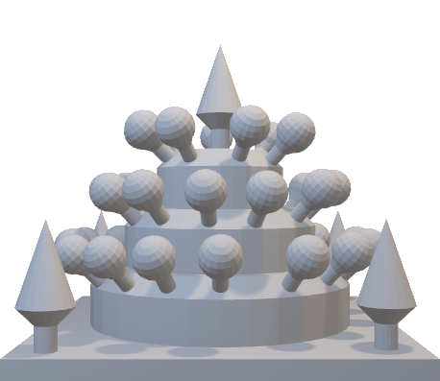
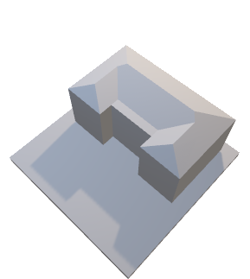






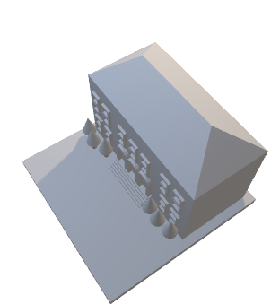
Machine Learning Component
Obtain the Datasets
Obtain the Datasets
Identify the problem ( Target )
Data Cleaning
Pick up the right features
Data preprocessing
Choose the right models
Evaluate the models
Try different combinations for better result
Finalize
Data Cleaning
Evaluate
Data Preprocessing
Machine Learning

Slide 5
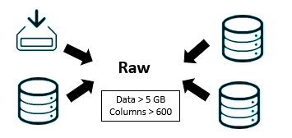
Obtain the Datasets

Slide 6
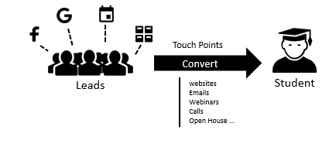

Identify the problem ( Target )
Based on hundreds of the touchpoints a student interacting with marketing and sales team, how likely a lead is going to convert to a real student

Slide 7

Process Defined in 4 Easy Steps
1. Data Cleaning & Pick up the right features
Data Cleaning ;
Clean Null ( fill in mean or drop or 0)
Data reformatting ( string, date, float.._)
Variance Filter (drop low variance column)
Keep import features (try to keep each feature independently)
Drop unrelated features but still keep essential information
Avoid highly correlated columns !

Slide 8
Process Defined in 4 Easy Steps
2. Data preprocessing
MinMaxScaler
Principal Component Analysis (PCA)
StandardScaler
One-hot Encoding

Slide 9
Process Defined in 4 Easy Steps
3.Choose Models
Naive Bayes
Logistic Regression
Classifier
Kneighbors
Decision Tree
Random Forest

Slide 10
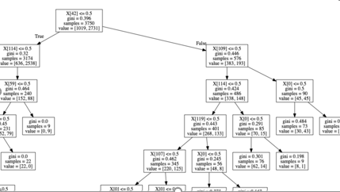
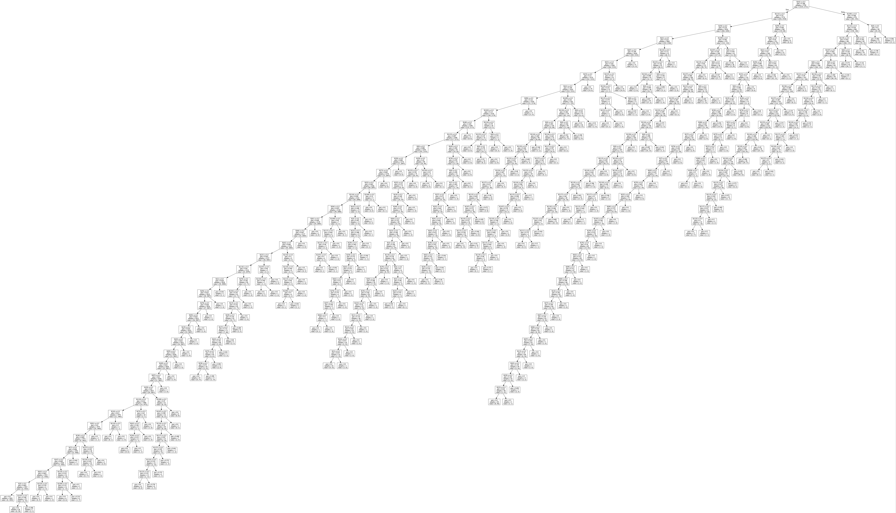
Example Of Decision Tree

Slide 11
Process Defined in 4 Easy Steps
4. Evaluate the models and try different combinations
GridSearchCV
Try different parameters and see which are the best parameters
Try Different Combinations of data preprocessing methods and features

Slide 12


Test Result
Kneighbors Best_Score: 0.85
Best_params :’n_neighbors’:10
Decision Tree Score: 0.87
Random Forest Best_Score: 0.88
Best_params: ‘max_depth’:25, ‘n_estimators’:200

Slide 13


Most important factors affect the conversion
INTL Event
Personal Score
Subscribed Emails
Website
Age
Country & City
Programs
Waive Application Fee
Source
Sales Campaigns
Education Agents
Not that Important

Slide 14
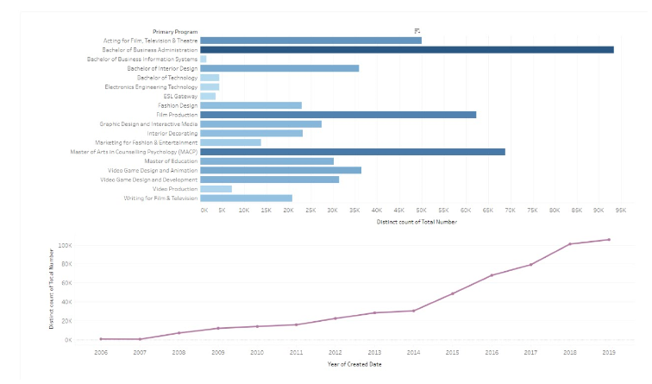
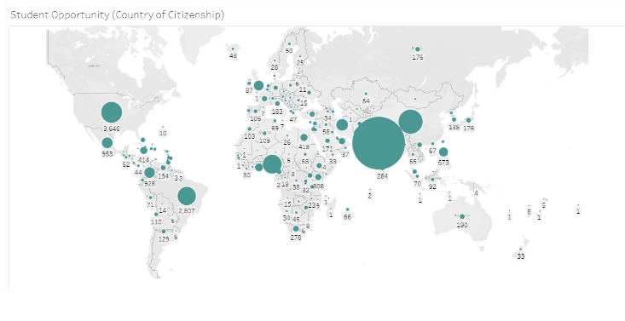
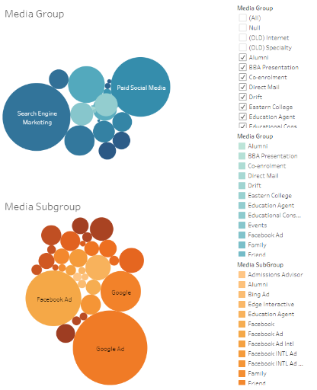
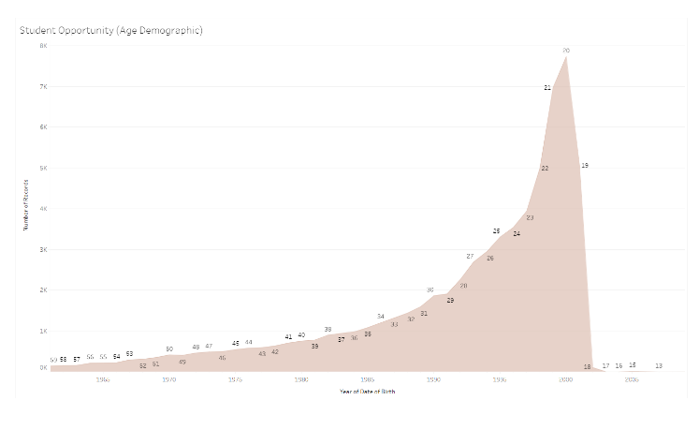
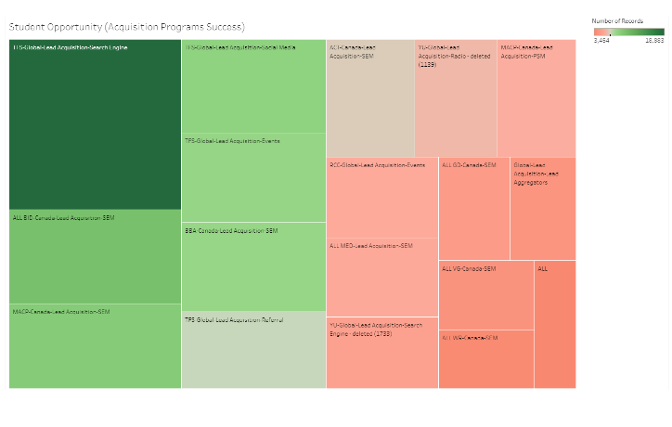
Student Opportunity(Age Demographic)
Primary Programs And Opportunity Growth
Media Group And Media Subgroup
Student Opportunity (Acquisition Program Success)

Slide 15

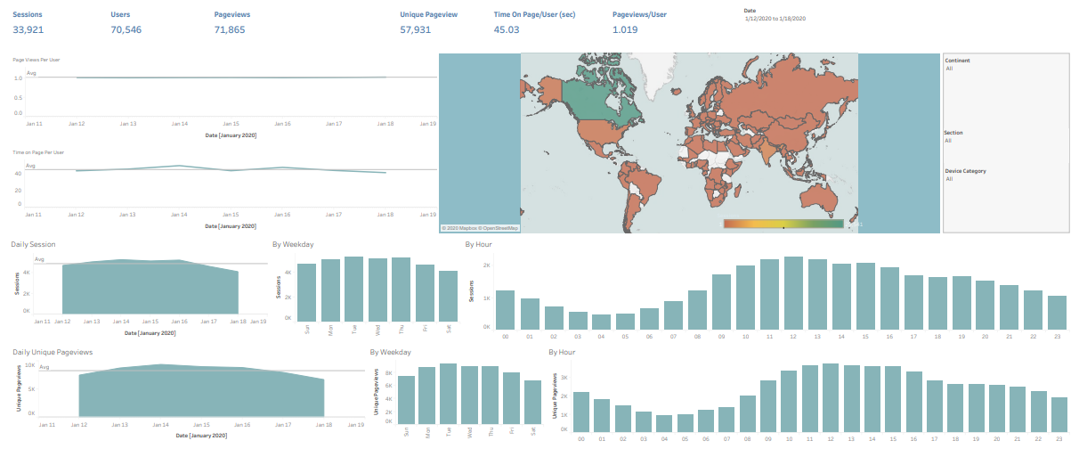
Weekly Website Traffic

Slide 16
Resources Used
Bootcamp Tutorial
Machine Learning with Scikit-Learn, Part 1 | SciPy 2018 Tutorial | Lemaitre and Grisel
Machine Learning with scikit-learn Part 2 | SciPy 2018 Tutorial | Lemaitre and Grisel
https://scikit-learn.org/stable/tutorial/index.html#tutorial-menu
LinkedIn Tutorials:
AWS Machine Learning by Example
Learning Amazon SageMaker
Creating Interactive Tableau Dashboards
YouTube Videos
How do I use pandas with scikit-learn to create Kaggle submissions?
Real-World Python Machine Learning Tutorial w/ Scikit Learn (sklearn basics, NLP, classifiers, etc)

